Slide 1
Computer Information Systems
CIS 2332 – Information Technology Hardware and Systems Software
ILT│CIS
Software Concepts
1

Slide 2
ILT│CIS
Software Categories Music Software Video Software Graphics Software
Mapping and Location-based Software
SECTION A: SOFTWARE BASICS
2

Slide 3
What is Software?
ILT│CIS
Software is a set of computer instructions or data.
Software receives input from the user and processes this input through the computer to produce output.
Software directs how the computer interacts with the user.
Software specifies how to process the user's data

Slide 4
Software System
ILT│CIS
Two categories: operating system (OS) software and application software.
Operating system software, also called system software, is the master controller for all activities that take place within a computer
Examples of OS software:
Microsoft Windows
Unix
Mac OS
iseries
Application software is a set of one or more computer programs that helps a person carry out a task
Examples of application software:
Microsoft Word
Internet Explorer
Macromedia Dreamweaver
Adobe Acrobat Reader
Users
Application Software
Operating System Software
Hardware System

Slide 5
Applications of Computer Systems
ILT│CIS
In Education
–Multimedia-Facilitated Learning
–Simulation-Based Education
–Intelligent Machine-Based Training
–Interactive Learning

Slide 6
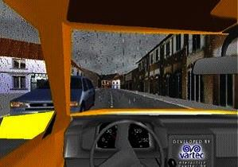
Applications of Computer Systems (continued)
ILT│CIS
In Business
–Supply Chain Management
–Project Management
–Customer Relationship Management
–Sales and Marketing Using Electronic Commerce
–Manufacturing Research
Figure Virtual simulation tool for automobile tire wear research

Slide 7
Applications of Computer Systems (continued)
ILT│CIS
In Entertainment
Movies
Video Games
Music
Digital Photography
Travel
Wearable Computer Systems
Developing new applications of computer systems:
Research at Carnegie Mellon University
Research at Massachusetts Institute of Technology Media Lab
Device Drivers

Slide 8
Device Drivers
ILT│CIS
A device driver is software that helps a peripheral device establish communication with a computer
On a Mac, you can click the Apple icon, select About this Mac, and then select More info to look at a list of devices connected to your computer
On a PC, if you need to update a device driver or change its settings, you can usually view driver information by accessing the Control Panel and selecting System (or System and Security)
8

Slide 9
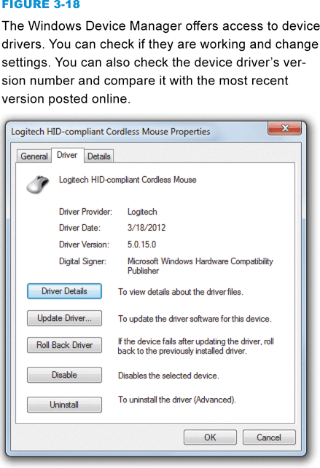
Device Drivers
ILT│CIS
9

Slide 10
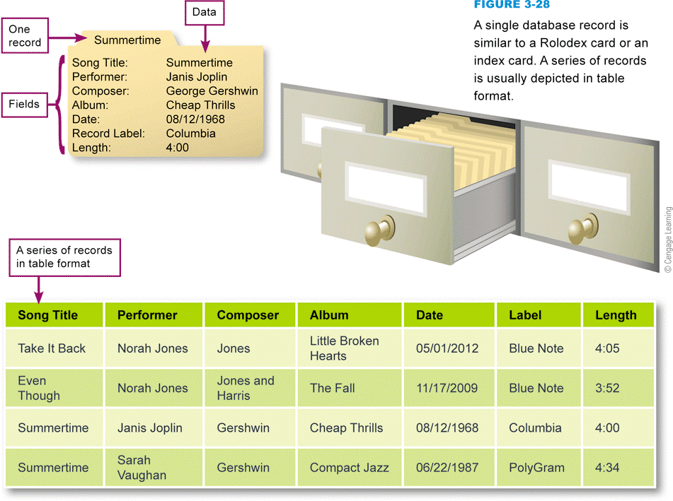
Databases
A database is a collection of data
Database software helps you enter, find, organize, update, and report information stored in a database

Slide 11
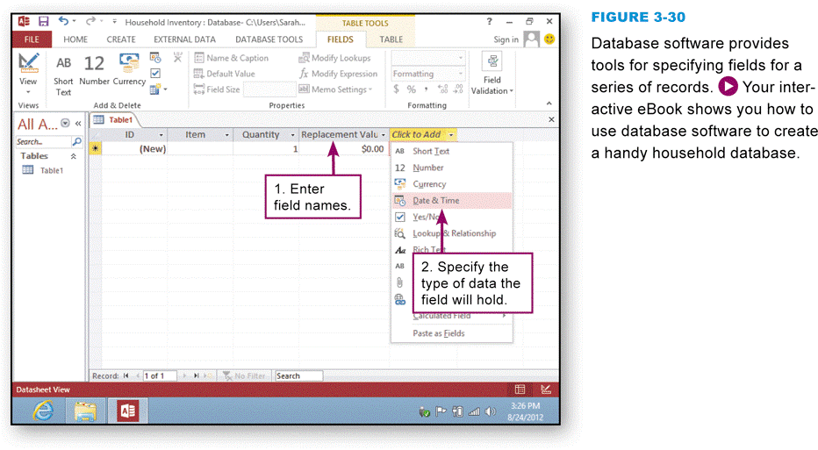
Databases

Slide 12
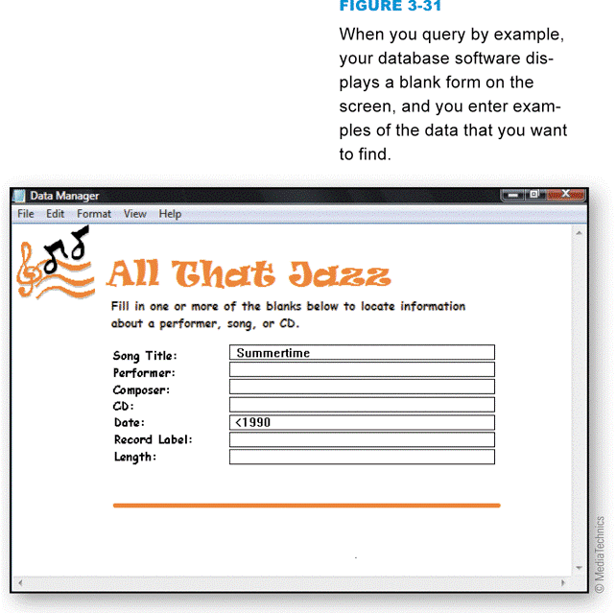
Databases
A query language such as SQL (Structured Query Language) provides a set of commands for locating and manipulating data
Natural language query
Keyword search
Query by example

Slide 13
ILT│CIS
Web Apps Mobile Apps
Local Applications Portable Software
Software Upgrades and Updates
Uninstalling Software
SECTION C: INSTALLING SOFTWARE AND UPGRADES
10

Slide 14
Web Apps
ILT│CIS
Software installation is a process that places a program into a computer so that it can be run or executed
A Web application, or Web App, is software that is accessed with a Web browser
Example of cloud computing
Many are associated with consumer sites
Most require no installation at all on your local computer or handheld device
Mobile Apps
Local Apps
Portable Software

Slide 15
Software Upgrades and Updates
ILT│CIS
Periodically, software publishers replace older versions of a software product with a new version that’s sometimes referred to as a software upgrade
A software update is a small section of program code that replaces part of the software you currently have installed
– Service packs

Slide 16
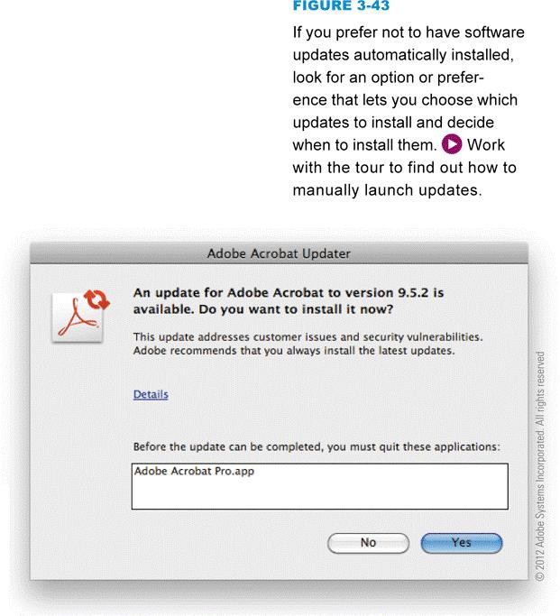
Software Upgrades and Updates
ILT│CIS
Many software applications allow you to set your preferences for how you would like to receive notifications and updates
It is always a good idea to install updates and service packs when they become available

Slide 17
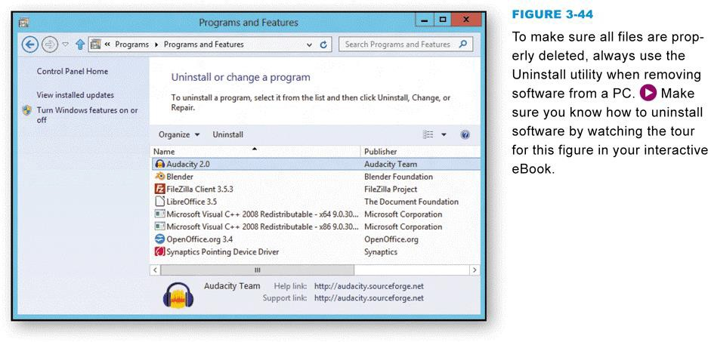
Uninstalling Software
ILT│CIS
Uninstall routines delete the software’s files from the various folders on your computer’s hard disk
14

Slide 18
ILT│CIS
Consumer Basics
Software Copyrights and Licenses
SECTION D: BUYING SOFTWARE
15

Slide 19
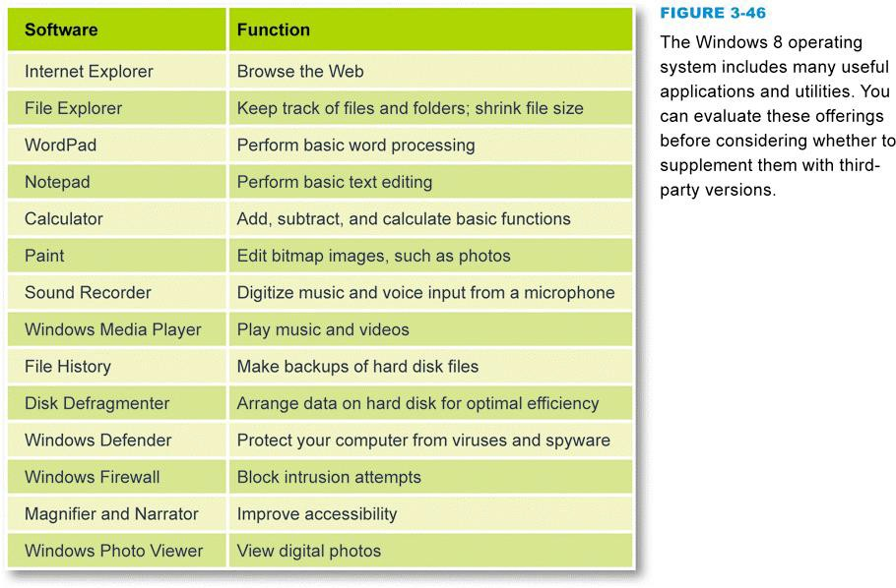
Consumer Basics
ILT│CIS
Most operating systems include a handful of small applications and a good variety of useful utility software
16

Slide 20
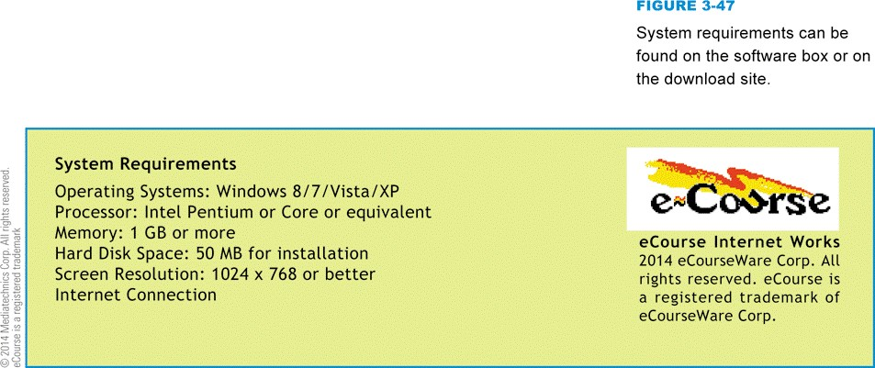
Consumer Basics
ILT│CIS
System requirements specify the operating system and minimum hardware capacities necessary for a software product to work correctly

Slide 21
Software Copyrights and Licenses
ILT│CIS
A copyright is a form of legal protection that grants the author of an original work exclusive rights
Copyright notice
Software licenses, also called license agreements, define the ways in which you may use a computer program
Single-user license
Site license
Multiple-user
Shrink-wrap license

Slide 22
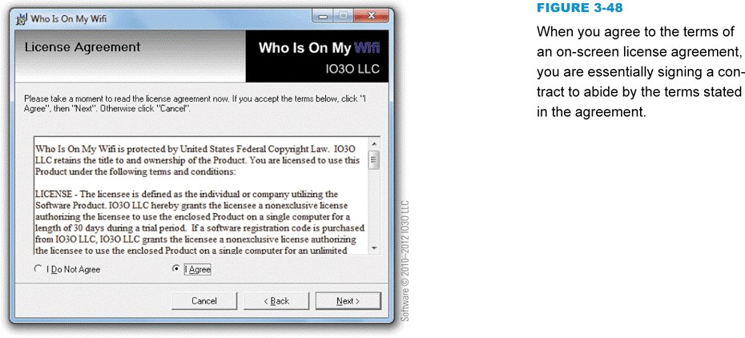
Software Copyrights and Licenses
ILT│CIS
EULA (End-User License Agreement)
Different types of software licenses
Public domain
Proprietary
Commercial software
Demoware
Shareware
Open source
BSD
GPL
22

Slide 23
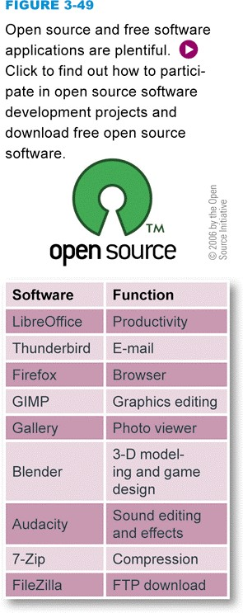
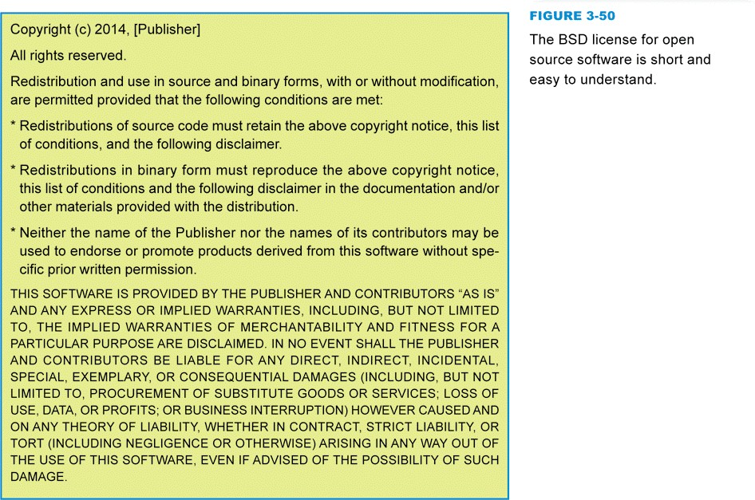
Software Copyrights and Licenses
ILT│CIS
23

Slide 24
Software Copyrights and Licenses
ILT│CIS
Freeware is copyrighted software that is available for free
Product activation is a means of protecting software from illegal copying by requiring users to enter a product key or activation code before the software can be used
– A hash value is a unique number derived from encoding one or more data sets, such as names, serial numbers, and validation codes
21

Slide 25
ILT│CIS
Security Software Basics
Security Suites
Antivirus Modules
SECTION E: SECURITY SOFTWARE
22

Slide 26
Security Software Basics
ILT│CIS
Security software is designed to protect computers from various forms of destructive software and unauthorized intrusions
The terms malicious software and malware refer to any computer program designed to covertly enter a computer, gain unauthorized access to data, or disrupt normal processing operations

Slide 27
Security Software Basics
ILT│CIS
Computer virus
A computer virus is a set of program instructions that attaches itself to a file, reproduces itself, and spreads to other files. A common misconception is that viruses spread themselves from one computer to another. They don’t. Viruses can replicate themselves only on the host computer.
Computer worm
A computer worm is a self-replicating program designed to carry out some unauthorized activity on a victim’s computer. Worms can spread themselves from one computer to another without any assistance from victims.
Mass-mailing worm
Trojan horse
A Trojan horse is a computer program that seems to perform one function while actually doing something else. Unlike a worm, a Trojan is not designed to spread itself to other computers. Also differing from viruses and worms, most Trojans are not designed to replicate themselves. Trojans are standalone programs that masquerade as useful utilities or applications, which victims download and install unaware of their destructive nature.
Remote Access Trojan (RAT)
Bot
Spider
Botnet
Spyware

Slide 28
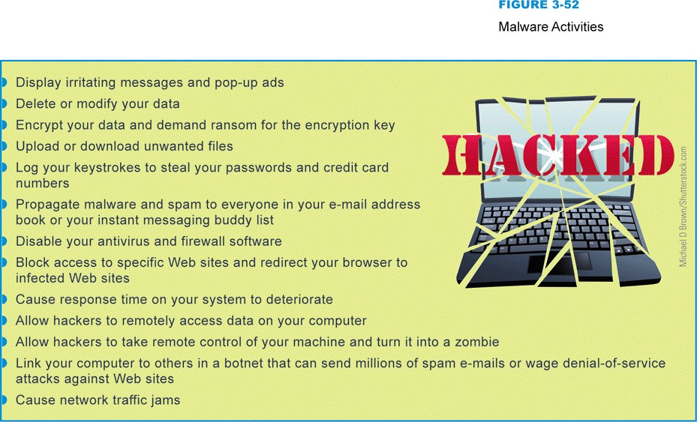
Security Software Basics
ILT│CIS

Slide 29
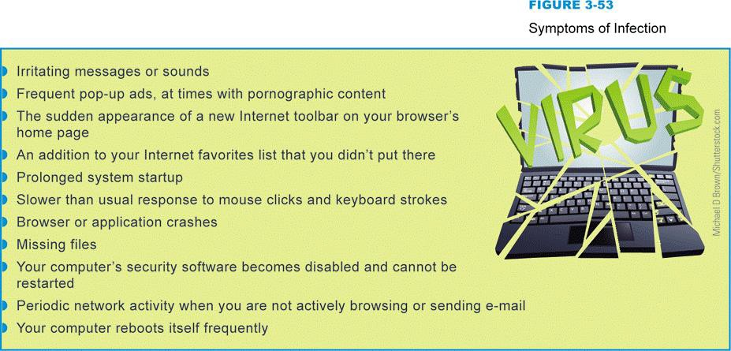
Security Software Basics
ILT│CIS

Slide 30
Security Software Basics
ILT│CIS
The term rootkit refers to software tools used to conceal malware and backdoors that have been installed on a victim’s computer
A virus hoax usually arrives as an email message containing dire warnings about a supposedly new virus on the loose

Slide 31
Security Suites
ILT│CIS
A security suite integrates several security modules to protect against the most common types of malware, unauthorized access, and spam
A security suite costs less than purchasing standalone security modules
28

Slide 32
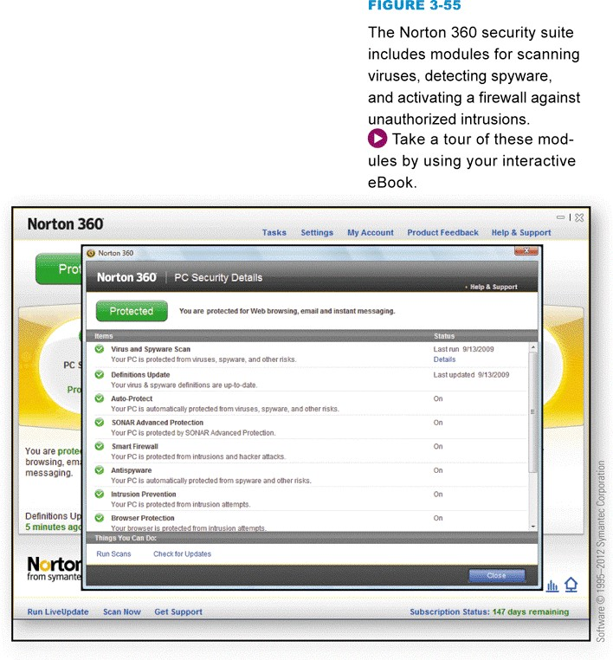
Security Suites
ILT│CIS

Slide 33
Antivirus Modules
ILT│CIS
Antivirus software is a type of utility software that looks for and eradicates viruses, Trojan horses, worms, and bots
A virus signature is a section of program code, such as a unique series of instructions, that can be used to identify a known malicious program, much as a fingerprint is used to identify an individual
Virus signatures and other information that antivirus software uses to identify and eradicate malware is stored in one or more files usually referred to as virus definitions

Slide 34
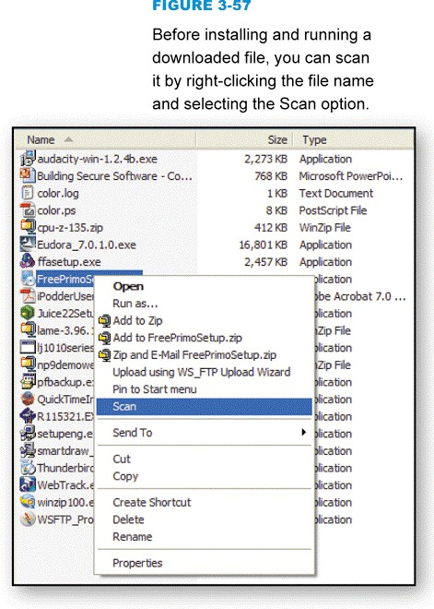
Antivirus Modules
ILT│CIS
Most experts recommend that you configure your antivirus software to periodically scan all the files on your computer
If, during the scanning process, your virus protection software identifies a virus, worm, Trojan horse, or bot in a file or attachment, it can try to remove the infection, put the file into quarantine, or simply delete the file
31

Slide 35
Discussion
ILT│CIS
Questions
Comments
32
Suggestions
Concerns
32

